Slide 1


The Importance of Preventative Care
An ounce of prevention is worth a pound of cure
Pioneer HealthCare Clinic

Slide 2

What is Health?
Complete physical, mental, & social well-being
NOT simply the ABSENCE of disease or illness
Notes:
World Health organization defines health as
"a state of complete physical, mental, and social well-being and not merely the absence of disease or infirmity” (WHO, n.d., p.1).

Slide 3

National Prevention Strategy
Goal: Improve quality of life by focusing on preventative care and overall wellness
Vision: Increase number of healthy Americans at all ages of life
Notes:
Goal: “ Working together to improve the health and quality of life …by moving …from a focus on sickness and disease to …prevention and wellness” (CDC, 2014, p.1).
Vision: “Increase the number of Americans who are healthy at every stage of life (CDC, 2014, p.1).

Slide 4

Why is prevention important?
70% of deaths in the US are caused by chronic disease
  Examples of chronic disease include: High blood pressure, high blood sugar (diabetes), and high cholesterol (heart disease)
Notes:
Prevention of disease7 out of 10 deaths in US are due to chronic illnesses
Many chronic illnesses like hypertension, Diabetes, High Cholesterol are preventable
Yearly wellness exams help prevent chronic illnesses and help catch diseases early

Slide 5
Why is prevention important?
These chronic illness are PREVENTABLE
We PREVENT these chronic diseases with yearly wellness exams and laboratory studies to catch disease EARLY!

Slide 6

Major Medical Conditions Affecting America
Overweight and Obesity
Heart Disease
Stroke
Cancer
Notes:
http://www.cdc.gov/nchs/fastats/leading-causes-of-death.htm
Heart disease: 614,348
• Cancer: 591,699
• Chronic lower respiratory diseases: 147,101
• Accidents (unintentional injuries): 136,053
• Stroke (cerebrovascular diseases): 133,103
• Alzheimer's disease: 93,541
• Diabetes: 76,488
• Influenza and pneumonia: 55,227
• Nephritis, nephrotic syndrome, and nephrosis: 48,146
• Intentional self-harm (suicide): 42,773

Slide 7

Overweight and Obesity
Who is affected in the United States?
  1 in 3 adults are overweight or obese
  1 in 5 children ages 6 - 19 years are obese
Health risks associated with Obesity:
  Heart disease
  High Blood Pressure
  Type II Diabetes
  Arthritis related problems
  Cancer

Slide 8

Heart Disease and Stroke
Heart disease is the number one cause of death and disability in the US
Stroke is the 4th leading cause of death in the US
Notes:
http://www.cdc.gov/nchs/fastats/leading-causes-of-death.htm

Slide 9

Are you at risk for Heart Disease or Stroke?
High Blood Pressure
High Cholesterol
Diabetes
Smoking
Physical Inactivity
Overweight and Obesity

Slide 10
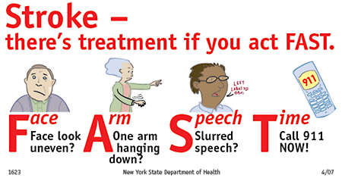
Are you having a stroke?

Slide 11
Cancer
Second leading cause of death in the US
Most common cancers:
  Breast cancer, cervical, prostate, lung and colorectal cancers
Notes:
http://www.cdc.gov/nchs/fastats/leading-causes-of-death.htm

Slide 12
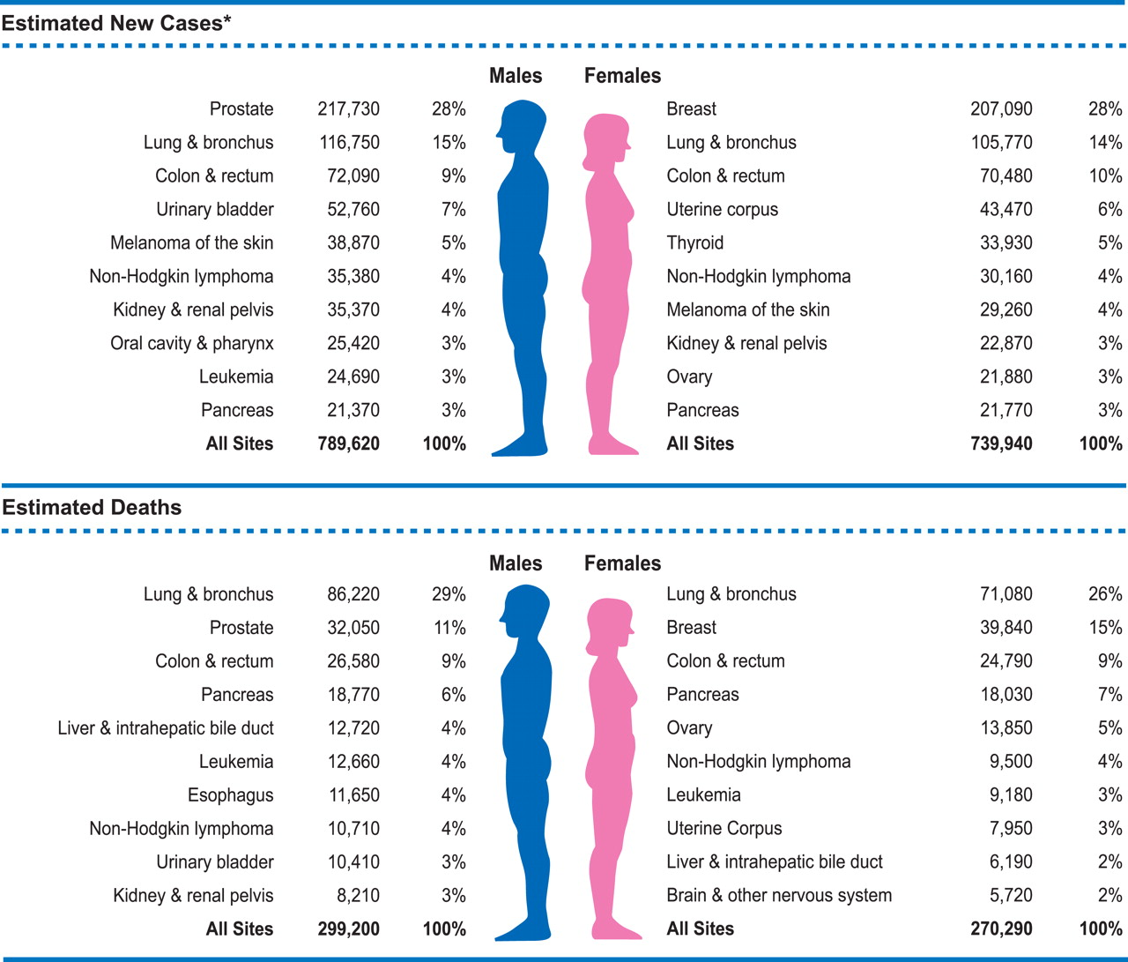

Slide 13
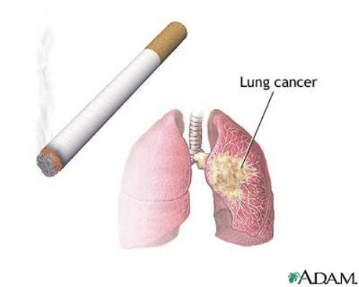
Lung Cancer
Leading cause of cancer-related death
  Are you at risk?
    Family history of lung cancer
    Exposure history: Asbestos
    Smoking
      Smokers are 80% more likely
      to develop lung cancer
      Both first & second hand
      smoking can lead to cancer

Slide 14

Breast Cancer
Most common newly diagnosed cancer in women
  1 in 8 women will develop breast cancer in their lifetime
  1 in 4 women with a first degree relative with breast cancer will also develop breast cancer.
2nd Leading cause of cancer-related death in women
  1 in 36 women die from Breast
  Cancer in the US every year

Slide 15

Breast Cancer
Are you at risk?
  Non-modifiable risk factors:
    Increased Age, Race, Family History
  Modifiable risk factors:
    Smoking, Drinking, Diet
Early detection:
  Screening: Annual Mammogram
  starting at age 50 and earlier if
  at higher risk

Slide 16

Cervical Cancer
Most common cancer in women world wide
The incidence of invasive cervical cancer has decreased in the United States by 74% since 1992 thanks to preventative care
Early detection has an almost
100% chance of cure.

Slide 17
Cervical Cancer
Are you at risk?
  Being infected with Human Papilloma Virus:
    Strains HPV-16 and HPV-18 are the most common causes of cervical cancer
  Several sexual Partners
  Smoking, Obesity
Early Detection
  Screening: Pap Smears every
  1-3 yrs starting at age 21
    +/- HPV testing
Notes:
<21 years: Recommends against screening for cervical cancer in women < 21 years (D)
<30 years: Recommends against cervical cancer screening using HPV alone or with cytology in women <30 years. (D)
21-65 years: Recommends screening for cervical CA in women ages 21-65 years with cytology (Pap smear) every 3 years or with cytology and HPV every 5 years in women ages 30-65. (A) (AAFP, ACS concurs)
>65 years: Recommends against routinely screening women older than age 65 (D) for cervical cancer if they have had adequate recent screening with normal Pap smears and are not otherwise at high risk for cervical cancer. (ACOG, ACS recommends stopping screening >70 if at least 3 neg Paps in 10 yrs.)
Women with hysterectomy with no h/o HGSIL, CIN 2 or 3 or cervical cancer
Recommends against routine Pap smear screening in these women (D) (ACOG, ACS concurs)
First screening – Begin at age 21
Biennial screening until age 30
At 30 and after:
Screen q3 years after 3 normal paps
Combined cytology and HPV DNA – if both negative then screen q3+years
Women with HIV, immunosuppressed, h/o CIN/Cancer, or who have been exposed to DES need to be screened more often.
Hysterectomy:
no screening needed after removal of the cervix for benign reasons and with no history of abnormal or cancerous cell growth.
Discontinue screening at age 65 or 70 if 3 negative consecutive Paps and no abnormal tests in 10 years

Slide 18

Colorectal Cancer
Third leading type of cancer in Men and Women
Early Detection by Screening:
  Stool Tests (FOBT) 3 separate samples annually
  OR
  Sigmoidoscopy every 5 years with FOBT every 3 years
  OR
  Colonoscopy every 3-10 years
    Depending on results

Slide 19
Colorectal Cancer
Are you at risk?
  Inflammatory Bowel Disease
    Crohn’s Disease, Ulcerative Colitis
  Personal/Family History of Colorectal Cancer or Polyps
  Lack of Physical Activity
  Overweight/Obesity
  Poor Diet, Alcohol Use
  Smoking

Slide 20

Prostate Cancer
Most common newly diagnosed cancer among men in the US
Affects quality of life in 33% of men older than 50 years.
Notes:
The USPSTF recommends against PSA-based screening for prostate cancer. (D Recommendation) (2012)
AAFP and CDC agree with above
American Cancer Society (ACS):
Men>50yrs who have at least a 10-y life expectancy should have an opportunity to make an informed decision with their health care provider about whether to be screened for prostate cancer, after receiving information about the potential benefits, risks, and uncertainties associated with prostate cancer screening. Prostate cancer screening should not occur without an informed decision-making process.
Prostate cancer is sensitive to testosterone levels
Increased levels can stimulate prostate cancer to grow
Treatment for prostate cancer typically involves inducing surgical or chemical hypogonadism
Increasing prostate specific antigen levels can be an indicator of prostate cancer
Increasing PSA levels can also be an indicator of simple BPH
Prostate cancer is caused by aberrant cells in the prostate
Benign Prostatic Hypertrophy (BPH) is the enlargement of the prostate
BPH can (and most typically does) occur without prostate cancer
Prostate cancer can occur without BPH

Slide 21
Prostate Cancer
Are you at risk?
  Age > 50 years
  Family History
  Race (African Americans are
  at higher risk)
  Diet – High fat intake
Preventative Screening
  Prostate Specific Antigen and Digital Rectal Exam annually starting at age 50.
Notes:
PSA velocity
Use at least 3 measurements over at least 18 months.
When to be suspicious for CA:
PSA velocity of 0.35 ng/mL/year if PSA < 2.5 ng/mL
PSA velocity of 0.75 ng/mL/year if PSA 4-10 ng/mL
Free PSA
If 25% or more of PSA is free, cancer is less likely
If 10% or less of PSA is free, cancer is more likely
Age-adjusted PSA
Consider PSA cutoff of 2.5 ng/mL for fifth decade, 3.5 ng/mL for sixth
decade, 4.5 ng/mL for seventh decade
Some also suggest race-adjusted PSA

Slide 22
Let Pioneer Healthcare Clinic help you prevent chronic disease and improve your quality of life

Slide 23
Questions? www.PioneerHealthcareClinic.com
(972) 295-9090

Slide 24
References
American Cancer Society. (n.d.). Breast Cancer. Retrieved from http://www.cancer.org/cancer/breastcancer/detailedguide/breast-cancer-risk-factors
American Cancer Society. (n.d.). Prostate Cancer Statistics. http://www.cancer.org/cancer/prostatecancer/detailedguide/prostate-cancer-key-statistics
Cancer Treatment Centers of America. (n.d.).Prostate Cancer Risk Factors http://www.cancercenter.com/prostate-cancer/risk-factors/
CDC. (n.d.). Gynecological Cancers. Retrieved from http://www.cdc.gov/cancer/gynecologic/index.htm
CDC. (n.d.). Developmental Monitoring and Screening. Retrieved from
NCCC. (n.d.). Cervical Cancer Overview retrieved from http://www.nccc-online.org/hpvcervical-cancer/cervical-cancer-overview/
National Center for Chronic Disease Prevention and Health Promotion. (2009). The Power of Prevention. Retrieved from http://www.cdc.gov/chronicdisease/pdf/2009-power-of-prevention.pdf

